Slide 1
“Future Stores”
Supermarket Data Mining
Guided By- Submitted By-
Prof. O. P. Vyas Neelabh Singh(ISE2011003)
Kalyan Singh Meena(ISE2011004)

Slide 2
Contents
Abstract
Problem Domain
Solution Domain
Tools & Technology used
Use Case Diagram
Description of the System
CRC Diagrams
Class Diagrams
Implementation

Slide 3
Abstract
Develop a software which is meant for Business Analyst of “Future Stores” Supermarket. The software will perform Association Rule Mining on given transitional data of super market sales transactions and prepares Discouting policy by preparing Combo.

Slide 4
Problem Domain
The Business Analyst wants to prepare Discounting poilicies by preparing various Combos.
There are some frequent data items sets which may be grouped together for a given value of support and confidence in order to prepare a Combo.

Slide 5
Solution Domain
The software will perform Association Rule Mining on given transitional data of super market sales transactions for preparing various Combos.
The software will use the Apriori Algorithm for data mining.
It will graphically represents frequent items sets for given value of minimum support and confidence.

Slide 6
Tools & Technology Used
STAR UML
Java Beans
Swing

Slide 7
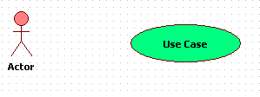
DESIGN
Use Case Diagram :
A use case diagram in the UML is a type of behavioral diagram defined by and created from a Use-case analysis. Its purpose is to present a graphical overview of the functionality provided by a system in terms of actors, their goals (represented as use cases), and any dependencies between those use cases.
The main purpose of a use case diagram is to show what system functions are performed for which actor. Roles of the actors in the system can be depicted.

Slide 8
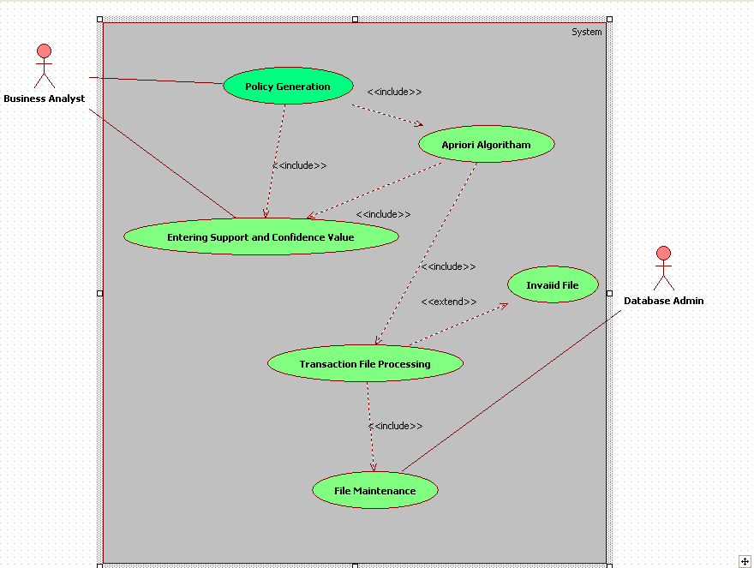

Slide 9
Text Description for the whole System
Scenerio 1: Mainline Sequence
  System: Display user interface to enter transaction file, minimum support, and minimum confidence.
  Analyst: Enter necessary values.
  System: Find and display the association rules.
Scenerio 2: at Step 2 of mainline sequence
  System: Displays the message to enter valid transaction file.

Slide 10
Contd…
Scenerio 3: at Step 2 of mainline sequence
  System: Displays the message that for minimum support or confidence values are not correctly specified. The system displays a prompt to enter valid values.
Scenerio 4: at Step 3 of mainline sequence
  System: Displays the association rules if any else a message is shown, showing no association rule found.

Slide 11
CRC Diagrams
A class responsibility collaboration diagram represent a collection of similar object, a responsibility something that a class know or does and a collaborator is other class that interact to fulfill its responsibility.
Class Name
Responsibility | Collaborator

Slide 12
Transaction File
Perform Transaction File Use Case
AprioriAlgo
Generate No. of transaction Generate Candidates Delete Infrequent Item Sets Calculate Support Count for each Candidate | Transaction File

Slide 13
PolicyGeneration
Generate Association rule from frequent ItemSets | AprioriAlgo

Slide 14
CLASS DIAGRAMS
a class diagram in the UML is a type of static structure diagram that describes the structure of a system by showing the system's classes, their attributes, operations (or methods), and the relationships among the classes. and So the purpose of the class diagram can be summarized as:
Analysis and design of the static view of an application.
Describe responsibilities of a system.
Base for component and deployment diagrams.
Forward and reverse engineering.

Slide 15
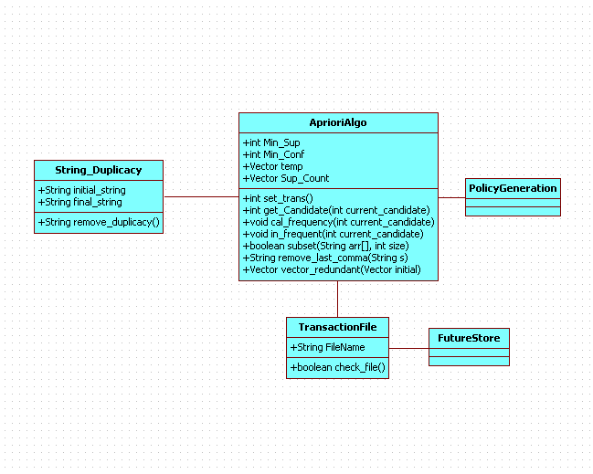

Slide 16
Implementation
Association Rule Mining :
Searches for relationships among items in a given data set.
These patterns can be represented in the form of association rules.
For eg, the customers who purchase computers also tend to buy financial management software-
computer=>financial_mgt_software

Slide 17
Contd…
Association rule mining is a two-step process:
  Find all frequent itemsets
  Generate strong association rules from the frequent itemsets.
These are calculated on the basis of two parameters – support , confidence.

Slide 18
Contd…
For given set of items A & B in transaction database D –
Support is the percentage of transactions in D that contain (A U B).
Confidence is the percentage of transactions in D containing A that also contain B.
  support(A=>B) = P(A U B)
  confidence(A=>B) = P(B|A) = support_count(A U B) / support_count(A)

Slide 19
Thank You…

